Slide 1

FLIGHT PRICE PREDICTION USING MACHINE LEARNING
PRESENTED BY: VIVEK RAUT

Slide 2
Abstract
Most of the people are not aware of buying a flight ticket at the right time. They pay more for the ticket than usual. The prices of the ticket may vary based on different factors. The prices of tickets may also fluctuate during day and night and also on number of tickets available. By considering certain features like departure time, arrival time, the numbers days remaining for the departure and based on time it gives the best time to purchase a ticket. By using the information of factors that influence change in airline fare prices and how the factors are related to change in the fare price of the ticket. By using the information above to built a system to predict the fare of the ticket priorly using machine leaning techniques like random forest , decision tree regressor, that might be helpful for the passengers whether to buy a ticket or not.

Slide 3
Introduction
There are some frequent passengers for the airlines, these people can be able to know when the airfare prices will be low and when it goes to high.
But there are many people who don’t know these fluctuations.
Airlines increases the price of the ticket for their Revenue management. The goal the carrier will be to built its income, while the person who wants to purchase a ticket will looks for the low cost.
One of the report says that India is in third biggest avionics showcase of the world in 2020.
Here we collect data from different websites and apply machine learning models.
We use different machine learning regression methods to predict the fare price at a given time.

Slide 4
OBJECTIVES
Aim of the Project:
The aim of the project is to predict dynamic fare price of the ticket by applying machine learning techniques on collected data.
Scope of the Project:
The scope of the project is to estimate minimum airfare over specific period of time.
Project Domain:
Data analysis is a process of extracting the useful information from the given set of information by analysing the data through various ML algorithms and techniques.

Slide 5
DATA FLOW DIAGRAM
The figure shows that data flow of the project . In this firstly the data is collected , then preprocessing is done to create the perfect data. After the training and testing the data is done by applying the machine learning techniques to get the output i.e prediction of flight ticket fare.
COLLECTION OF DATA
PREPROCESSING OF DATA
APPLY MACHINE LEARNING ALGORITHM
TRAINING THE DATA
TESTING THE DATA
GET THE OUTPUT

Slide 6
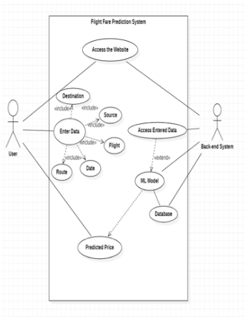
USE CASE DIAGRAM
The use case diagram say a lot about the framework. It shows the diagram in the view point of the user who is using the application or the framework. In this way use case is a situatation which shows the perspective of the project.

Slide 7
IMPLEMENTATION
Importing the necessary libraries
Reading the dataset

Slide 8
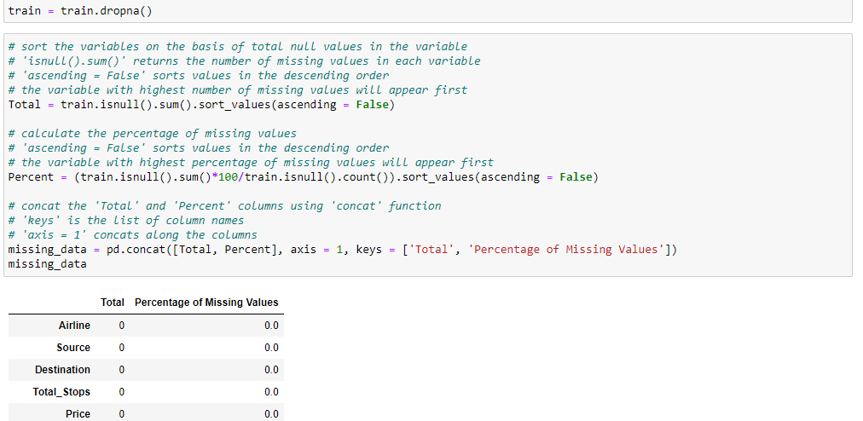
3. Dropping NAN values

Slide 9
4. Feature Engineering
We will pre-process our dataset. We will extract day and month from the column “Date of Journey” as the model will understand numerical value, for this we will use “pd.to_datetime” for day and month column. “dt.day” and “dt.month” will extract day and month respectively from the given column. Same process will be doing for the “dep_time” column, “Duration” column and “arrival_time” column and extract hours and min from it. After extracting day, month, hours and min, we will drop “Date of Journey”, “Duration”, “dep_time” & “arrival_time” column from our dataset.

Slide 10
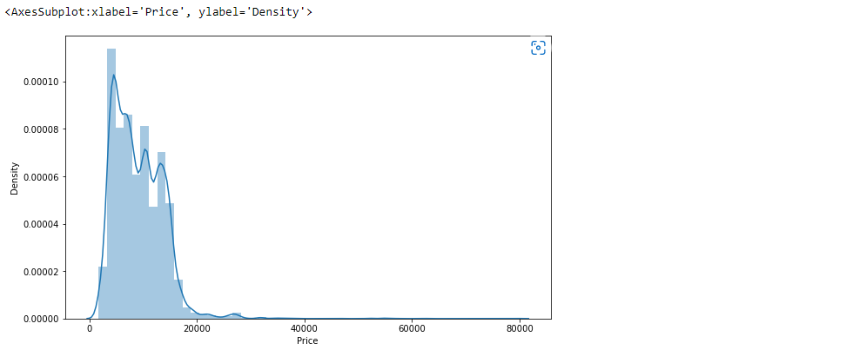
5. Exploratory Data Analysis
The exploratory data analysis plays a major role in the prediction of ticket price. It produce output for the model that created by the Machine learning techniques. The other important part in Exploratory Data Analysis(EDA) is handling categorical data, which helps to label the idea.

Slide 11
6. Handling Categorical Data
As we know the model understands numerical value, so we will convert all the categorical data into numerical data. For this we will perform “OneHotEncoding” method to convert it to numerical data. We will make dummies using pandas and perform “OneHotEncoding” on the “Airline”, “Source” and “Destination” columns. We will drop “AdditionalInfo” and “Route” columns as “Route” column contains same data as “Total_Stops” columns and “AdditionalInfo” column doesn’t have any additional info. “Total_Stops” column is ordinal type data so we will perform “LabelEncoder” and label each stop as 0,1,2,3,4. As the stop increases, the value also increases.

Slide 12
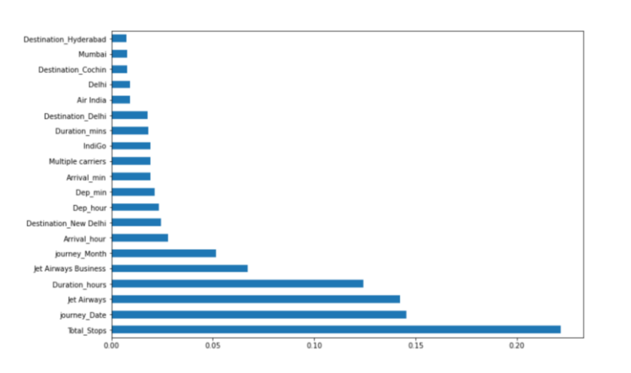
7. Feature Selection
In this process, we will find out the best feature which will contribute to our target variable. X = “Independent Feature” Y = “Dependent Feature” i.e., “Price” column. We will separate all the independent features except price in the X variable and price in Y variable. For this, we will use loc & iloc method. Now, we have used “ExtraTreesRegressor” to find more important features from the data. Use the selection variable and do fitting the X & Y features. After this we will print “feature_importance” and will get to know the important features. We get to know that “Total_stops” is playing as the most important feature.

Slide 13
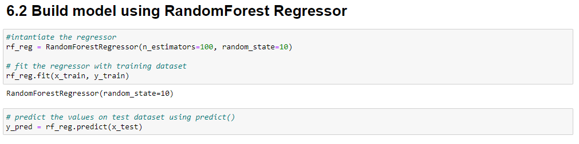
8. Applying Machine Learning Algorithm
Various Machine Learning techniques are used and after finding the accuracy , came to the conclusion that Random Forest has more accuracy rate. The Random forest is used for the analysis by splitting the data using scikitkearn. The accuracy may increase by implementing hyperparameter tuning, which consists of RandomizedSearchCV and GridSearchCV and then we can plot and predict the result.

Slide 14
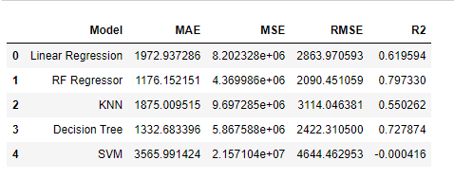
9. Result
Below is the comparison of the MAE, MSE & RMSE
RandomForest is best model here, as we got better r2 score and minimun RMSE.

Slide 15
10. Conclusion
This system customer can predict the flight price of a particular seat on a day before booking the flight tickets. It will provide an ease to the customer for the flight ticket booking. Travelers can save money if they choose to buy a ticket when its price is the lowest. The problem is how to determine when is the best time to buy ticket for the desired destination and project.

